Slide 1
Introduction
OMSE 531: Week 1
Joe Maybee

Slide 2
Welcome to CS 531
Your instructor: Joe Maybee
E-mail: jmaybee@pdx.edu
Available most any time, or by schedule
Class materials available via D2L
Lectures available via D2L “Elluminate”

Slide 3
Your Instructor
Experience: 34 years
Software / Firmware Engineer
Quality Assurance Engineer
Program Manager
Systems Engineer
Instructor at PSU
Software Engineering
Real-Time Systems
Software Quality Engineering

Slide 4

Course Textbook
Requirements Engineering
Fundamentals, Principles, and Techniques
Pohl, Klaus
Springer
1st Edition., 2010, XVII, 813 p. 314 illus.
Hardcover, ISBN 978-3-642-12577-5

Slide 5
The Course
Two examinations: Midterm and Final
Weekly, except for exam weeks:
Quiz on lecture
Discussion groups (Only on paper).
All quizzes and discussions close on Sunday Evenings at 10 PM
Two Assignments: Programming

Slide 6
Programming Assignments
First: A Knowledge Representation Paradigm.
Natural Language Specification Generation.
Relational Representation
Second: Checking Framework
Error Detection
Consistency Checking
Prolog: Logic Programming

Slide 7
Prolog
Logic Programming
Declarative Language
First-order Predicate Logic
Dialects:
ISO Prolog
Edinburgh Prolog
SWI-Prolog: Open Source

Slide 8
Course Coverage of Prolog
Presentations on Prolog at end of each class for first three classes.
Using SWI prolog implementation.
SWI prolog available at:
http://www.swi-prolog.org
Live presentation
Attendance not mandatory

Slide 9
Transformational Model
The Transformational Model of Software
Transform
Inputs
Outputs

Slide 10
Three Machine Paradigm
Defined “Machines”:
RM – Requirements
TM – Tests
IM – Implementation

Slide 11
Requirements Engineering
Focus on single activity within the SDLC
Activities in RE:
Elicitation of Requirements
Analysis of Requirements
Specification (Documentation) of Requirements
Validation of Requirements
Management of the RE process

Slide 12
Issues and Concerns
Domain Knowledge
Problem domain.
User problem.
Application Knowledge
Software Technology
Both knowledge areas are essential!

Slide 13
A Problem For Consideration
Knowledge Transfer:
Discovery
Communication
Analysis
Validation
Quality of Requirements are dependent on these elements

Slide 14
Amplification of Effect
“Fuzzy into Focus”
Orders of Magnitude?
1: Requirements
10: Design
100: Implementation
Huge leverage from requirements to code
Careful! It works both ways.

Slide 15
A Double Edge
An hour of good RE can have a huge positive effect on implementation.
An hour of bad RE can have a huge negative effect on implementation.
Consider:
An hour of bad RE discovered at implementation
Needs an hour of good RE to fix
Followed by a repetition of the associated design and implementation effort

Slide 16
Know What You Don’t Know
Management of information is essential.
Management of ignorance is just as essential.
Quality of information:
Is it right, is it wrong? Not that simple.
It is most likely right, it is most likely wrong.
The likelihood is unknown.
“Take 15 minutes and write down everything you don’t know.”

Slide 17
Assessing Requirements
How to check requirements:
How many are right?
How many are wrong?
How many are missing?
How many important requirements are there?
How many of the important ones are missing?
How many of the important ones are right or wrong?

Slide 18
Simple, Stupid, but … True
Only need to define the important requirements.
Only need to make sure the important requirements are correct.
Remove the unimportant requirements.
Consequently exhaustive specification (complete specification over the requirements space) is unnecessary and most likely a waste.

Slide 19
Is There Any Wisdom There?
There is if we can identify the “important” requirements.
The “Important” requirements are:
Requirements that distinguish an acceptable system from one that is not.
Requirements that distinguish an acceptable system from one that is not if they are correct.
How is it possible to acquire the important requirements?

Slide 20
Why so Difficult?
Misunderstanding
Miscommunication
Knowledge that isn’t knowledge.
This isn’t new, it’s been known for some time:
“Two important characteristics of maps should be noticed. A map is not the territory it represents, but, if correct, it has a similar structure to the territory, which accounts for its usefulness.”
-- Alfred Korzybski

Slide 21
Leveling Complexity
The ability of the mind to form abstract groups is one of it’s greatest strengths.
Grouping and abstraction allows me to categorize “cups” as a group, so I don’t need a specific name for every cup in existence.
Without this ability, the world would have overwhelming complexity.
Abstraction and grouping becomes a natural and reflexive thing for the mind to do.
This “knee-jerk” response often causes problems.

Slide 22
Natural Language
The medium of interpersonal communication is natural language.
The strength of natural language is it’s ability to accommodate ambiguity.
The communications path become lengthy

Slide 23
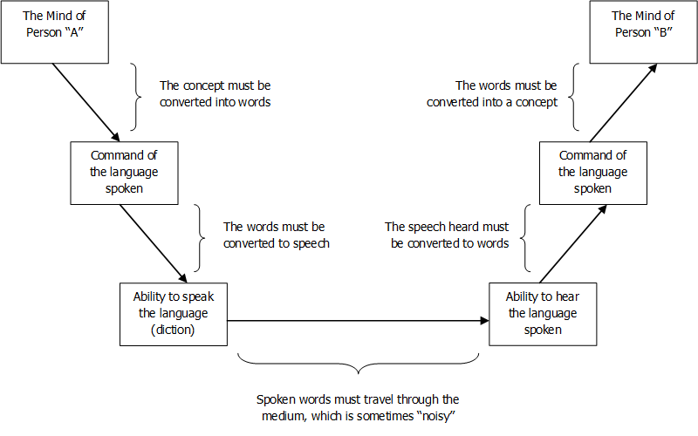
It’s Amazing We Can Communicate At All

Slide 24
Formality
If we can agree on some basic ideas and assign them words, it gets better.
“Thus, we see that one of the obvious origins of human disagreement lies in the use of noises for words. “
-- Alfred Korzybski
I find it interesting to note that Korzybski started out as an Engineer.

Slide 25
A Spectrum, not just Black and White
There is a continuum of formality from “none” to “complete”
Adding formality decreases misunderstandings, but out of necessity restricts flexibility.
Difficult to dictate practice to a team.
Best level is the level that can be tolerated

Slide 26
Questions?

